Slide 1

Chris Shenton
@shentonfreude
NASA Science Mission Directorate
chris.shenton@nasa.gov
Notes:
Browser-based calculations and 3D visualization.

Slide 2
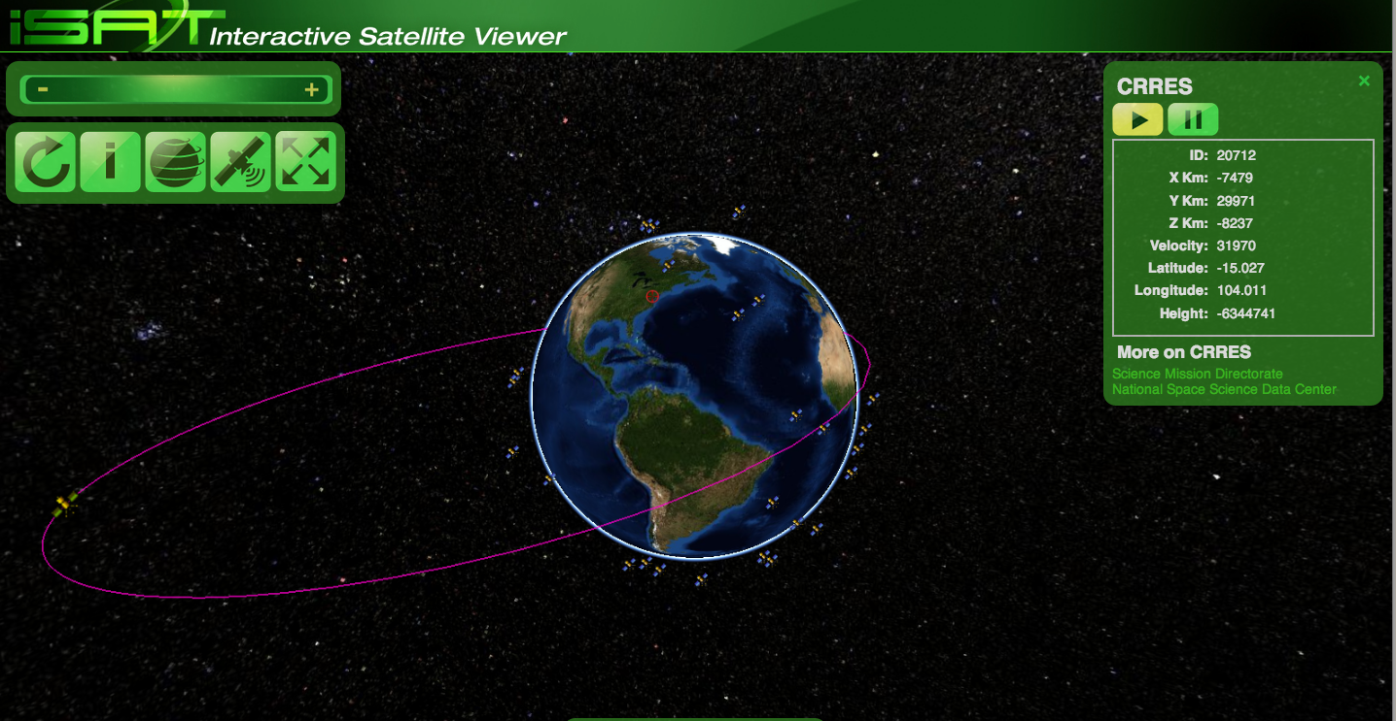
Notes:
Overview:
Background and history
How it’s built, and why
Demos in action

Slide 3
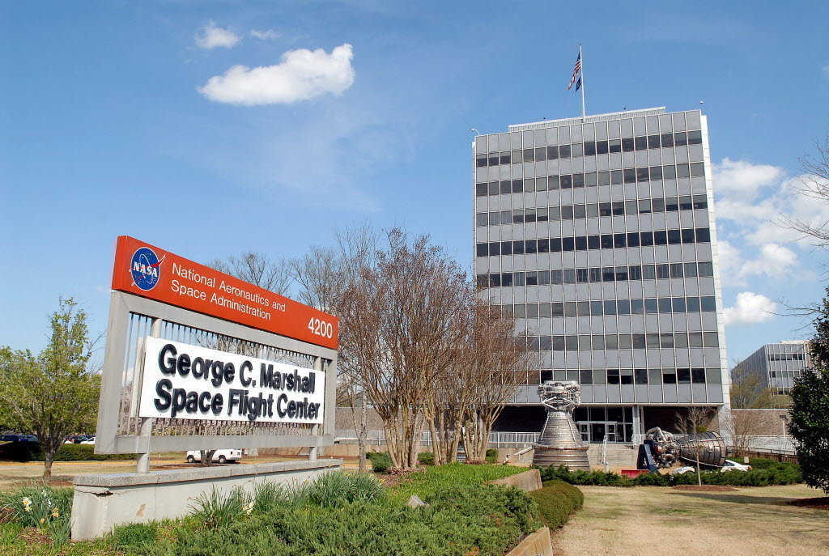
1998: Patrick Meyer, J-Track 3D
Notes:
In the 1990s, Patrick Meyer at NASA MSFC was working on Fortran and Java code to track satellites.
1997: J-Track,
1998: J-Track 3D. It required a 166 MHz CPU
Implemented as a Java applet, run by the browser (not on the server)
http://www.nasasolutions.com/software-catalog/MFS-32013-1-J-Track.php

Slide 4
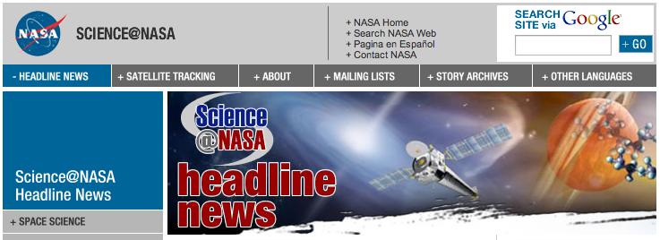
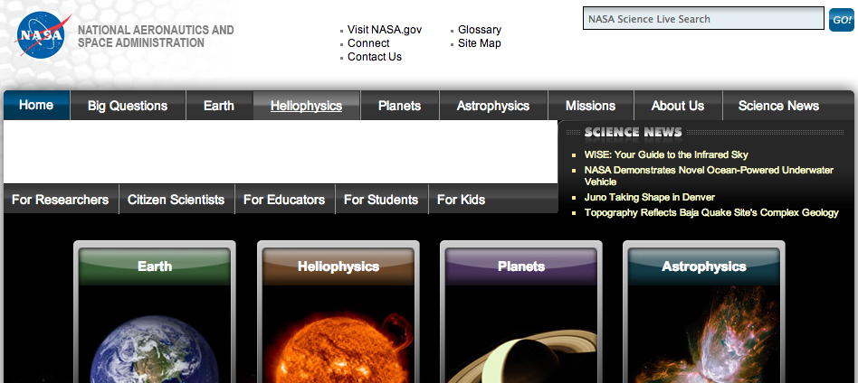
Science@NASA
2010
NASAscience
Notes:
MSFC’s Science@NASA which hosted J-Track 3D ran out of funding
April 2010 merged content into HQ’s NASAscience site: over 10 years of stories.
We lost the applet’s Java .class so J-Track 3D stopped.

Slide 5
Error 404
Notes:
This “Not Found” for J-Track was our biggest error in our web logs, by far.
We never realized how popular it was.
Found Java .class files on the Wayback Machine, decompiled it, got it working.
Tracked down Patrick Meyer and get the original code.

Slide 6
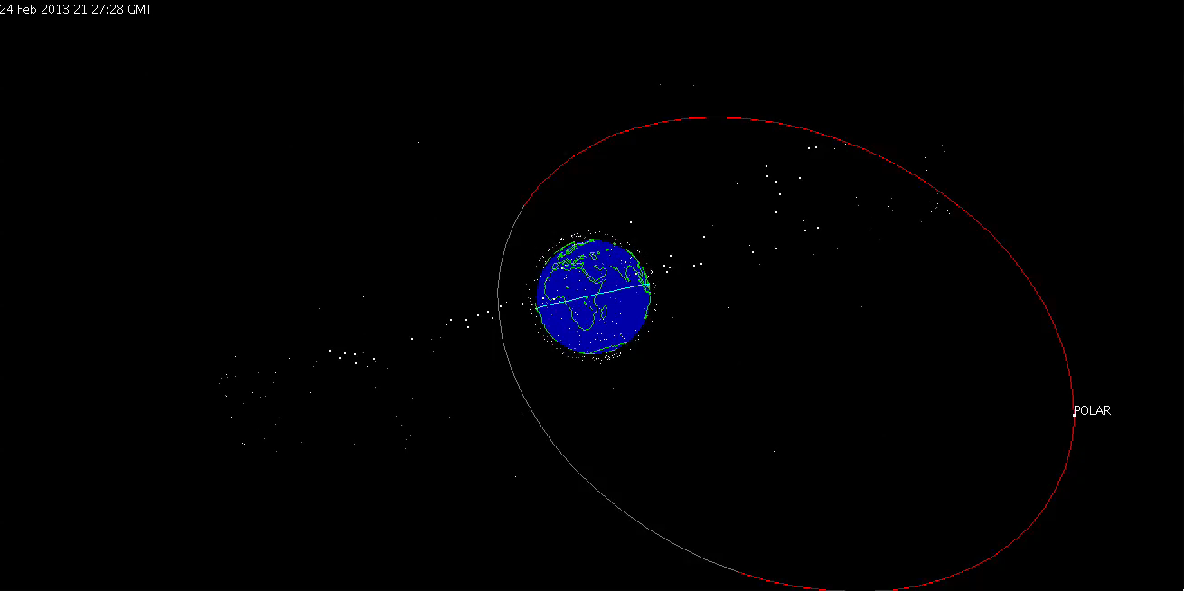
2011 Resurrection of the Dead
Notes:
32second screen cast of J-Track 3D and the POLAR satellite.
100x Realtime.
Cool it’s running again, runs fast on today’s hardware.
Instead of improving the old Java code, we decided to implement using modern approaches.
Java on the client side is getting less and less useful.
Vendor support is waning, Security threats are increasing.
How can we re-implement it?

Slide 7
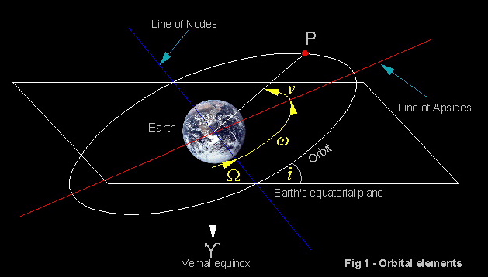
SGP model, TLE data
ISS (ZARYA)
1 25544U 98067A 13054.33198096 .00043022 00000-0 69361-3 0 2781
2 25544 51.6461 313.8194 0011796 301.9946 162.4257 15.52412156817027
Notes:
SGPs predict the effect of the Earth, Sun and Moon on satellite orbits. TLE examples: Red: name; blue: satellite number, green: international designator (YY+Number+Fragment); yellow: year; orange: day last sighted. The rest are parameters of the orbit, for example, pink indicates revolutions per day.

Slide 8

Math’s hard, let’s go shopping!
Notes:
The math is hard.
The SGP code is dense.
We could do calculations on server and stream to browsers, but…
if we have 1000 satellites and a million browsers, we’re going to crush the server.

Slide 9
JavaScript is Fast – Enough?
67,000 calculations/second !
Notes:
Can we do it in the Browser itself?
JavaScript turns out to be pretty fast.
Graph based on http://blog.famzah.net/2010/07/01/cpp-vs-python-vs-perl-vs-php-performance-benchmark/

Slide 10
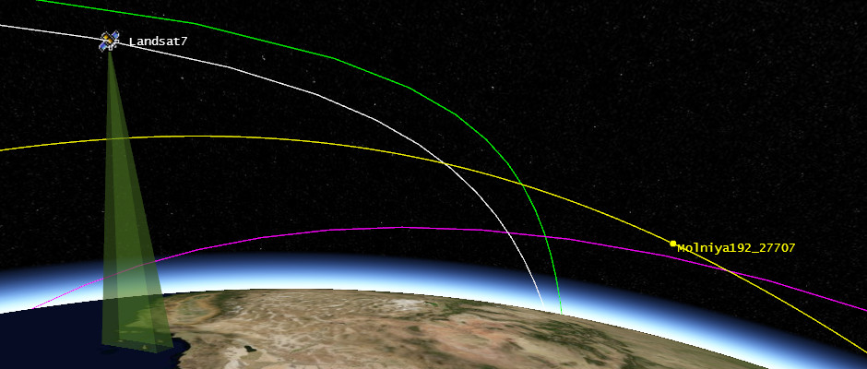

Visualization
Notes:
We have the positions, but how do we display them to users?
At last year’s NASA Open Source Summit, I ran into some folks from AGI who told me about work they were doing in satellite visualization. I
All JavaScript, using WebGL, running in the browser – perfect.
It’s open source, hosted in GitHub, and actively developed – currently at Beta 13.
Will it run in all browsers? Depends on WebGL support.
Support is improving – aim for the future rather than the past.

Slide 11

Demos
http://science.nasa.gov/iSat
Notes:
We’re just using screencasts here to show some of the interactivity.
Try it yourself!
(QR code from phone: phone may not run app well, try it on a desktop)

Slide 12
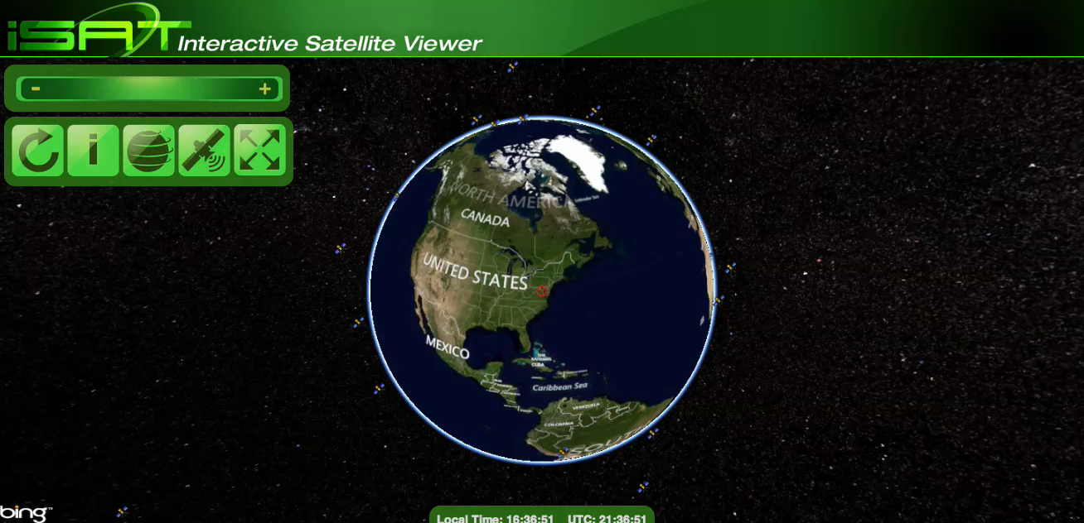
Demo 1: Zoom, Rotate, Motion
Notes:
Reset: fix orientation, centers on your geolocation.
Info: on basic usage.
Zoom out: show outlier satellites.
Rotate: show 3D with stars (looks great on full-screen)
Zoom in: show satellite flying over land in real time.

Slide 13

Demo 2: Satellite Info
Notes:
Hover: show name
Click: center on satellite; shows orbits, rotate to view.
Location pane; links to Science, NSSDC.

Slide 14
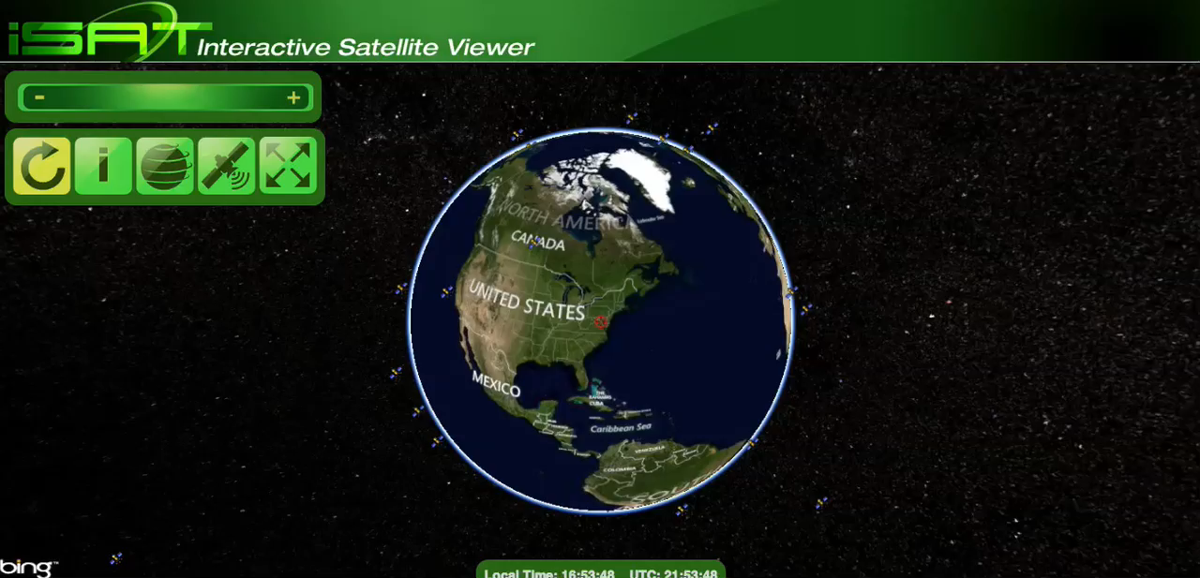
Demo 3: Globe, Satellite pickers
Notes:
Map tile provider: Bing, OpenStreetMap, ESRI, flat file for offline; back to ESRI. (pick a satellite to get orbit)
Projection: spherical; flat; “2.5D” flat map with satellites above.
Satellite picker:
- NASA Science, POLAR
- Geosynchronous, same radius, on Equator, hole over ocean, dense over the Americas.

Slide 15
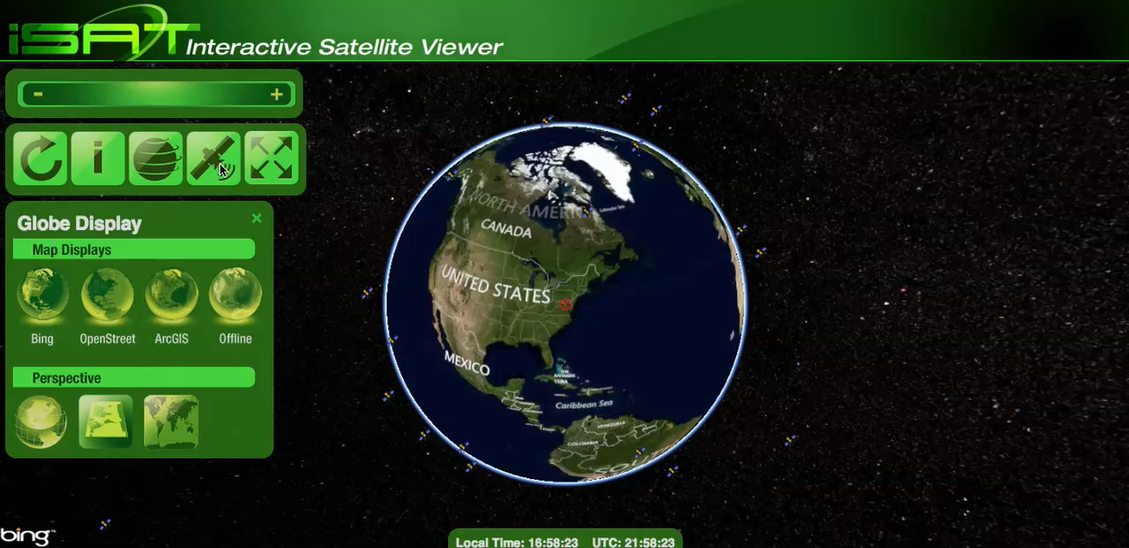
Demo 4: Space Junk
Notes:
1997 Chinese test of satellite killer destroyed Fengyun-1C.
Over 2000 golf-ball sized pieces of debris, over 150,000 particles.
All moving in different directions.
Still in orbit, posing a hazard to others.

Slide 16

Notes:
V1.0 Bugs and missing features
Bad location due to coordinate transformations.
Tighter integration with Science.nasa.gov and NSSDC.
Clock: x100, x1000 realtime
Better Android support in latest Cesium release.
Touch support for handheld devices.

Slide 17

Josh Finnie, Colleen Kaiser, Jenny Mottar: code, UI, UX, graphics
AGI, Cesium: awesome virtual globe engine
Ruth Netting, SMD: supporting this project
SXSW, NASA: letting me debut iSat here
Notes:
Team who helped build it
Cesium community for virtual globe engine
SMD and NASA for supporting the development
SXSW for letting me debut it here

Slide 18
Play with it!
http://science.nasa.gov/iSat
@shentonfreude
chris.shenton@nasa.gov

